Slide 1
Reading With Your Eyes
Ashkan Bozorgzad, Kyle Diederich, Suhas Kumar, Ziqi Su

Slide 2
Problem Formulation
Converting the eye tracking into the precision text highlighting (tracking) during reading:
Appropriate User Interaction:
Gaze Trace options: Touch at gaze, Scroll at gaze, Mouse wrap on move, ….
Text detection:
Object characteristics: Shape, Dynamic or fix, Size
Action after detecting the text:
Click a button to do something on the detected object
Limitation of the Tobii eye engine
Speed of reading

Slide 3
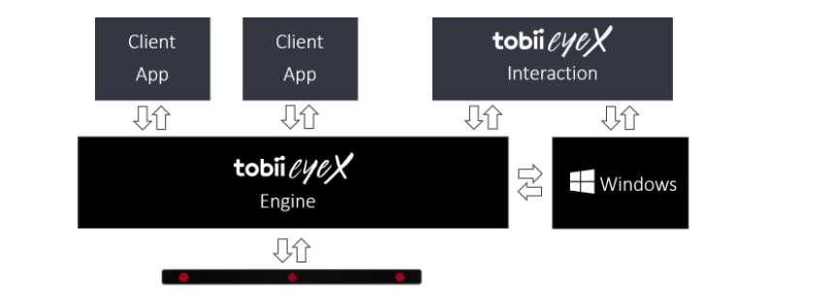
General Idea
Tobii EyeX Engine is the core software. It knows how to configure and talk to the eye tracker.
Client Application get uer’s eye-gazing and other input
Tobii EyeX Interaction is a software built on Tobii eyeX Engine, it offer a set of basic eye-gaze interaction in Windows environment
Tobii EyeX SDK give developer access to Tobii EyeX Engine API

Slide 4
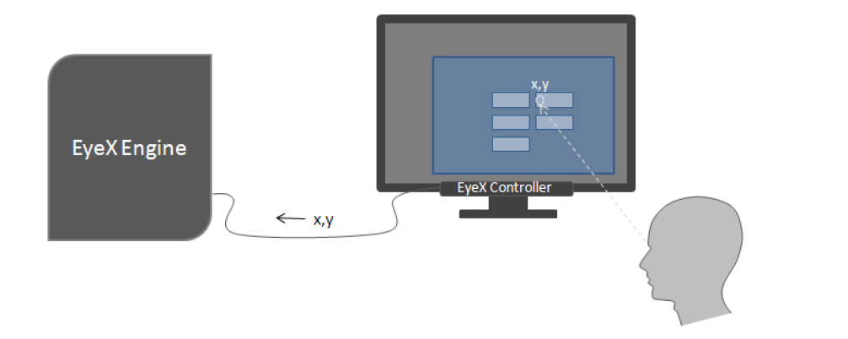
How the engine work
The user looks at the screen, the EyeX controller calculates the coordinates of the gaze point
EyeX engine use information from client application and understand what kind of object the user is looking at and how to interact with it
Client application combine some user input and eye gazing to trigger the click on an object

Slide 5
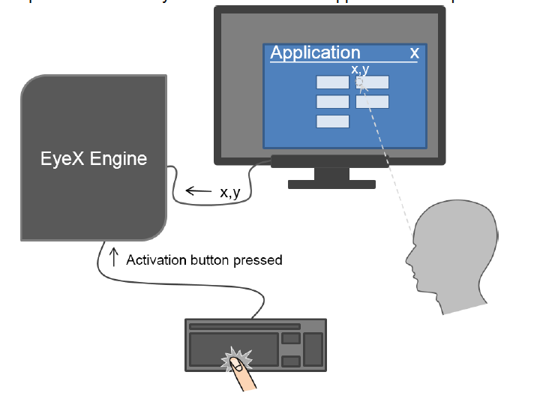
4. The user press space bar when he or she is looking at the object and client application will tell EyeX engine that user want to activate the button. EyeX engine will trigger an event and tell client application to activate the specific button
5. Client application response to the event and give visual feedback.
Difference:
In step 3, instead of having some user input and eye gazing to trigger an event, we want to only use eye gazing to trigger a click on an object.
We want to trigger an event after eye gazing an object for a period of time

Slide 6
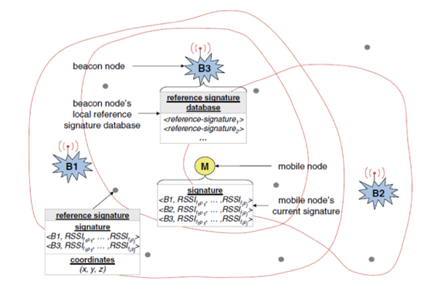
Example of Approach

Slide 7
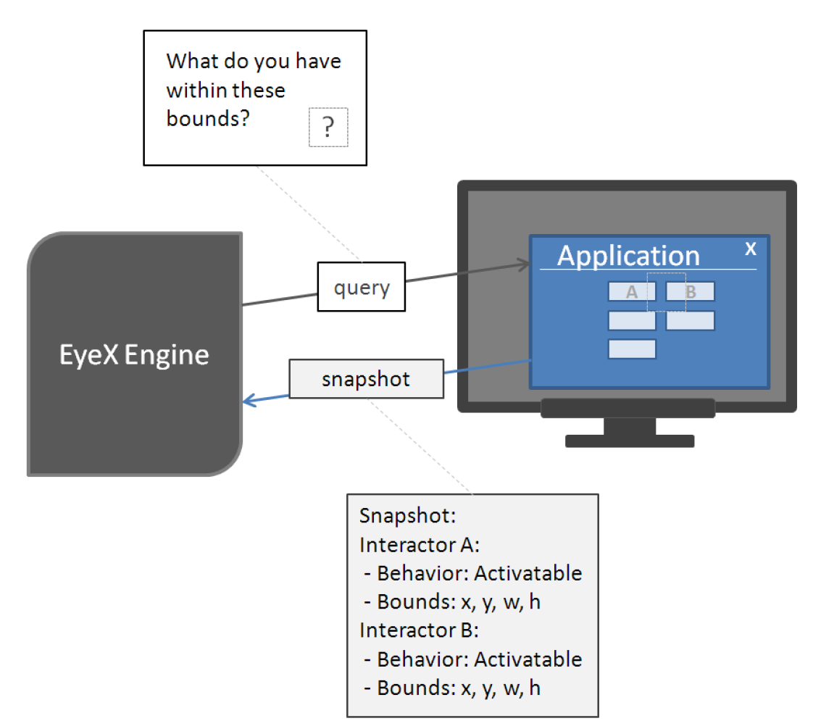
The Query Snapshot Cycle
First attempt to determine how to create interactors within application
Requires both keyboard and gaze in conjunction
Process:
Press key to activate snapshot
EyeX Engine queries screen to determine what item occurs at coordinates of user gaze

Slide 8
Gaze-Aware Behavior
Create a set of items that are interactable subject to user’s eye-gaze
Launch event when user’s gaze enters boundaries of interactor
Apply delay time
Add inertia to account to rapid, random eye movements
Gaze point must start on interactor until response is triggered
Manually adjustable delay parameter
Provide focus points:
Visual hotspot: captions, buttons, etc.
Sufficiently separation. Spacing around/between visual elements and/or increased size. (Tobii developers note: spacing effective than size.)
Care in visual feedback given. Example, highlight only text or visual hotspot of button.

Slide 9
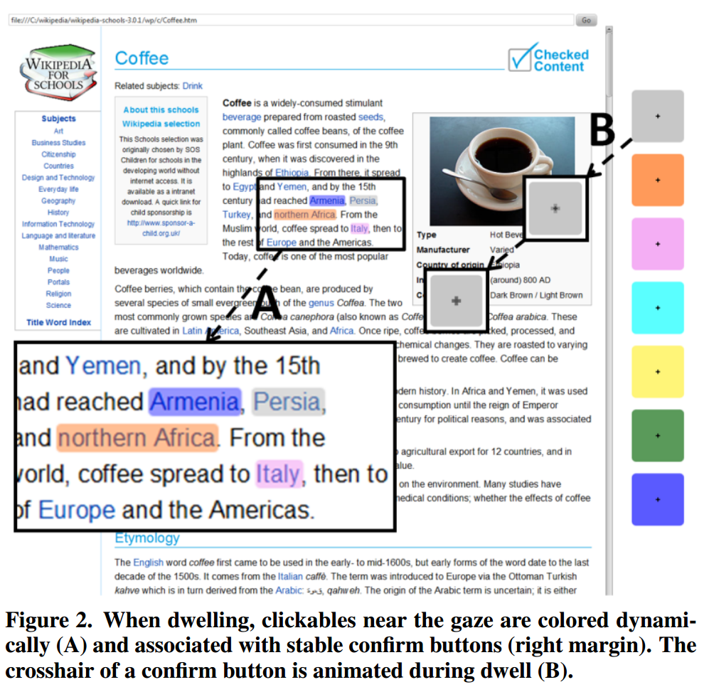
Gaze vs. Mouse
Gaze tends to be quick and natural
Can be slow and error prone
Difficulty distinguishing between intended or unintended gaze
actigaze
Attempts to solve the problem by using color coordination to confirm gaze targets
Allows for hands-free browsing of webpages
Current implementation only on selected Wikipedia articles (offline)
Requires algorithm to correctly identify and highlight clickable links
Lutteroth et al. 2015

Slide 10
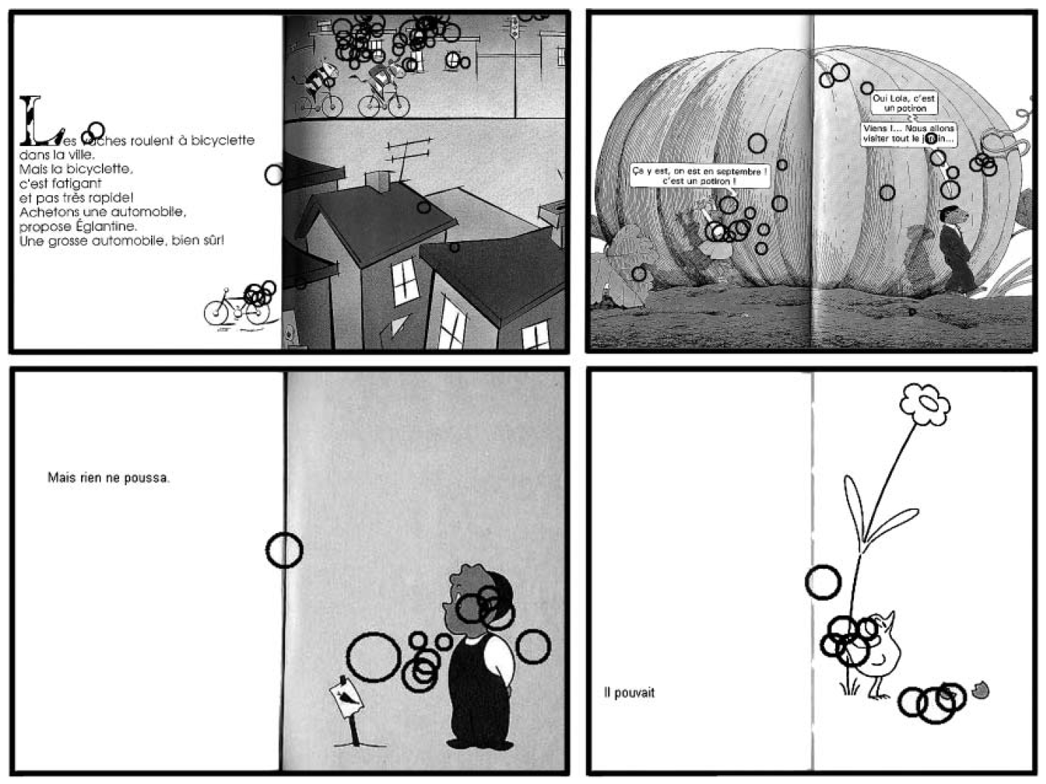
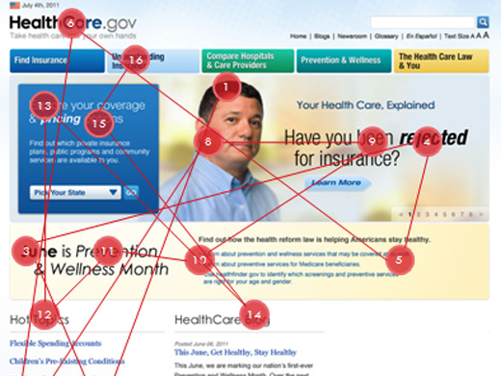
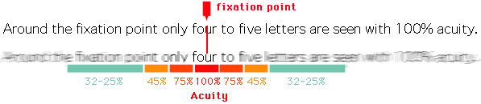
Where does gaze fall?
Evans and Saint-Aubin, 2005
Retrieved from Usability.gov
Retrieved from Wikipedia

Slide 11
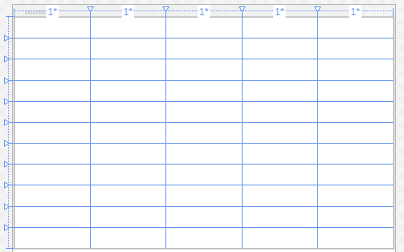
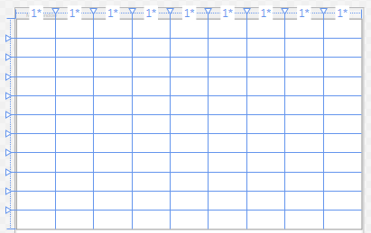
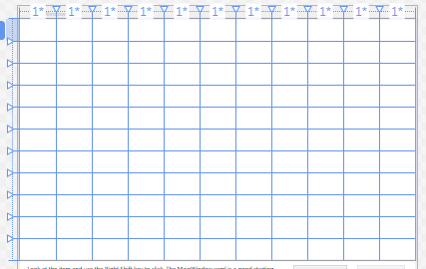
Experimentation for the Textbox Size
Goal: Determining reasonable word spacing amount:
5 initial textbox sizes were selected
11 * 5 grid line
11 * 9 grid line
11 * 11 grid line

Slide 12
Experimentation for the Textbox Size
Goal: Determining reasonable textbox size:
The accuracy for each textbox sized were calculated
$Acuracy= \frac{Correcly detected word}{Total number of word}$

Slide 13
Experiment for the Delay Amounts
Goal: Determine reasonable delay
Delay governs when text is activated
Setup various amounts of manual delay:
Delay in milliseconds: 250, 500, 750, 1000
Ask participants to read segment of text where is word requires delay to activate
Participants rate user experience on Likert Scale of 1 to 5
Require participants to provide feedback explaining choice
Plan to choose average amount as acceptable delay

Slide 14
Experiment on Spacing between Interactors
Goal: Determine reasonable spacing between Interactors.
Setup by placing space between text in various lengths:
Length in centimeters: 0.25, 0.5, 0.75, 1, 1.25, ….. 3.
Ask participants to read segment of text to determine the right amount of spacing required to activate the text, to achieve higher accuracy.
Participants rate user experience on likely scale of 1 to 5
Require participants to provide feedback explaining choice of space.
Plan to choose average amount as acceptable spacing between Interactors.

Slide 15
Demo
Story
Gaze Only
What you will observe in the Story ?
MAGIC
Text highlight
Sound production
Gaze navigation

Slide 16
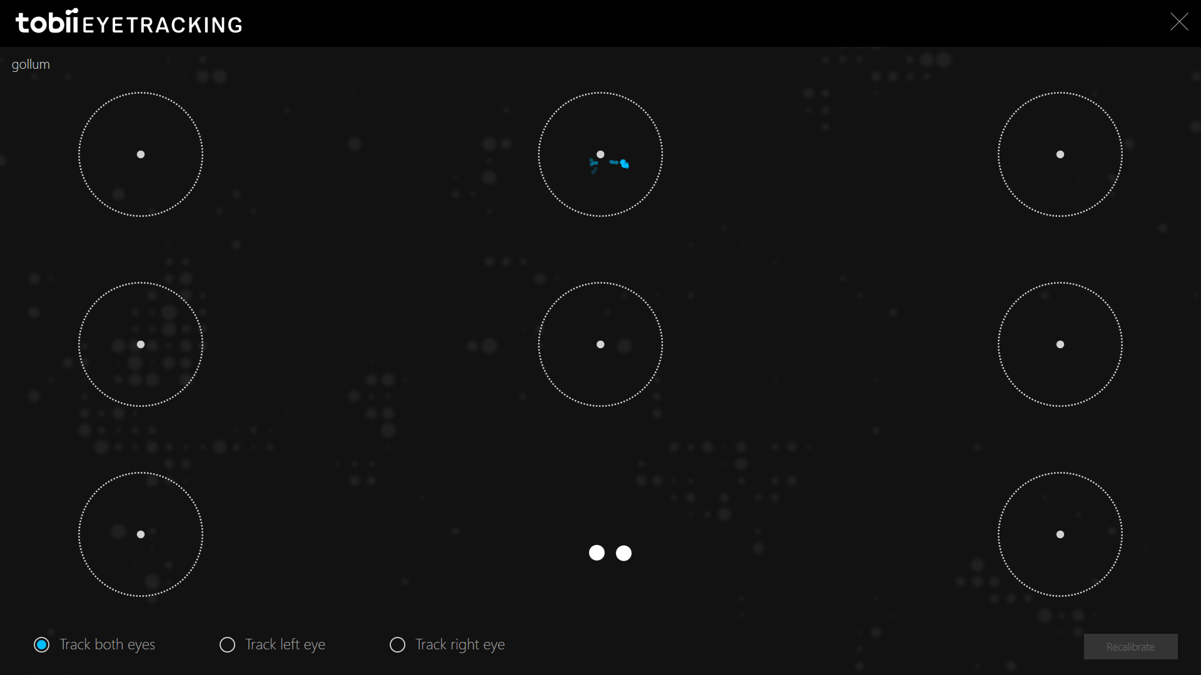
Demo
First Thing to do - Calibration

Slide 17
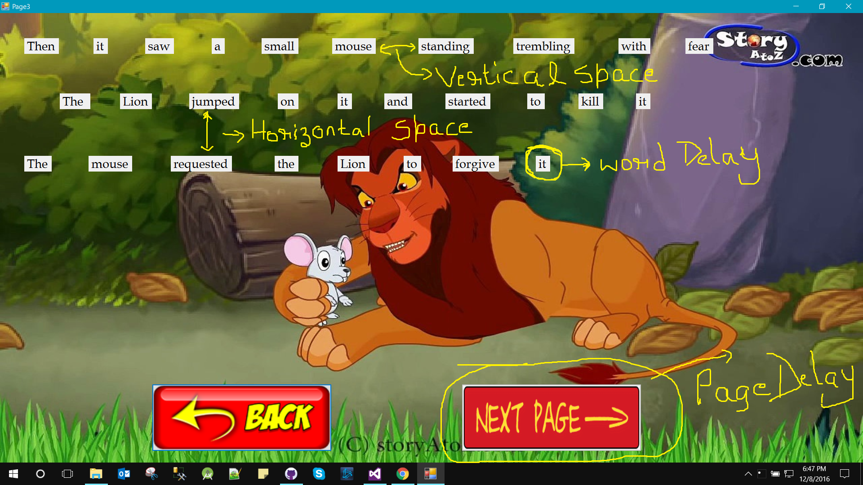
Demo
1. Vertical Space 3. Word Delay
2. Horizontal Space 4. Page Delay

Slide 18
References
Evans, M. A., & Saint-Aubin, J. (2005). What children are looking at during shared storybook reading evidence from eye movement monitoring. Psychological Science, 16(11), 913-920.
Eye Tracking. https://www.usability.gov/how-to-and-tools/methods/eye-tracking.html. (Retrieved Nov 11).
Lutteroth, C., Penkar, M., & Weber, G. (2015, November). Gaze vs. Mouse: A Fast and Accurate Gaze-Only Click Alternative. In Proceedings of the 28th Annual ACM Symposium on User Interface Software & Technology (pp. 385-394). ACM.

